Slide 1
E-MEDICARE
GROUP 1 :PROJECT MEMBERS
1. Abhijit Bandu Jawale
2. Abhishek G R
3. Alaparthi Sai Madhavi
4. Byrraju Bala Durga Kiran Raju
5. Deepika Jaibeeb Sivara
6. Kajal Ashok Gaikwad
7. Khdija khan
8. Nilesh Dharmraj Tale
9. Sahil Khan
10. Tupili Sai

Slide 2
CONTENTS
Abstract
Introduction
Proposed system
Technology used
Environment
Modules
ER Diagram
UML Diagram
Output
Advantages
Conclusion
Future Scope
References

Slide 3
ABSTRACT
The purpose of E-Medicare System is to automate the existing manual system by the help of computerized equipment's and full-fledged computer software, fulfilling their requirements, so that their valuable data/information can be stored for a longer period with easy accessing and manipulation of the same.
E-Medicare System, as described above, can lead to error free, secure, reliable and fast management system.

Slide 4
INTRODUCTION
The “E-Medicare” has been developed to override the problems prevailing in the practicing manual system. This software is supposed to eliminate and reduce the hardships faced by the existing system. Online Medical Store can lead to error free, secure, reliable and fast management system.
“E-Medicare" - web application, where users can register, login, purchase medicines e.g. Antibiotics, Antipyretics, Analgesics and manage their orders in the system.

Slide 5
PROPOSED SYSTEM
The proposed E-Medicare system will completely Revolutionize the industry.
Searching of Medicine, order placing, billing and Medicine add-delete can be maintained by a single click.
The order placed can be easily tracked at any time. The payment of the order can also be done by credit cards.

Slide 6
TECHNOLOGY USED
HTML : Page layout has been designed in HTML
CSS : CSS has been used for all the designing part
JSON: Server and Database
Typescript: Business Logic
Angular CLI : Command-line interface tool that we use to initialize.
Jasmine : For unit testing
Postman : For Functional testing

Slide 7
ENVIRONMENT
The system will be developed on any Windows OS machine And Using JSON Server.
Intel hardware machine (PC i3-2.26 GHz, 4GB RAM, 1 TB HDD)
Server – JSON
Database – JSON
Node Version 10
Angular CLI
Visual Studio Code

Slide 8
MODULES OF E-MEDICARE SYSTEM
Login Module: Used for managing the login details
Admin Module: Used for managing medicine details and user information.
Users Module: Used for managing the users of the system.
Medicine Module: Used for managing the Medicine details
Customer Module: Used for managing the Customer details.
Order Module: Used for managing the details of Order
Payment Module: Used for managing the details of Payment

Slide 9
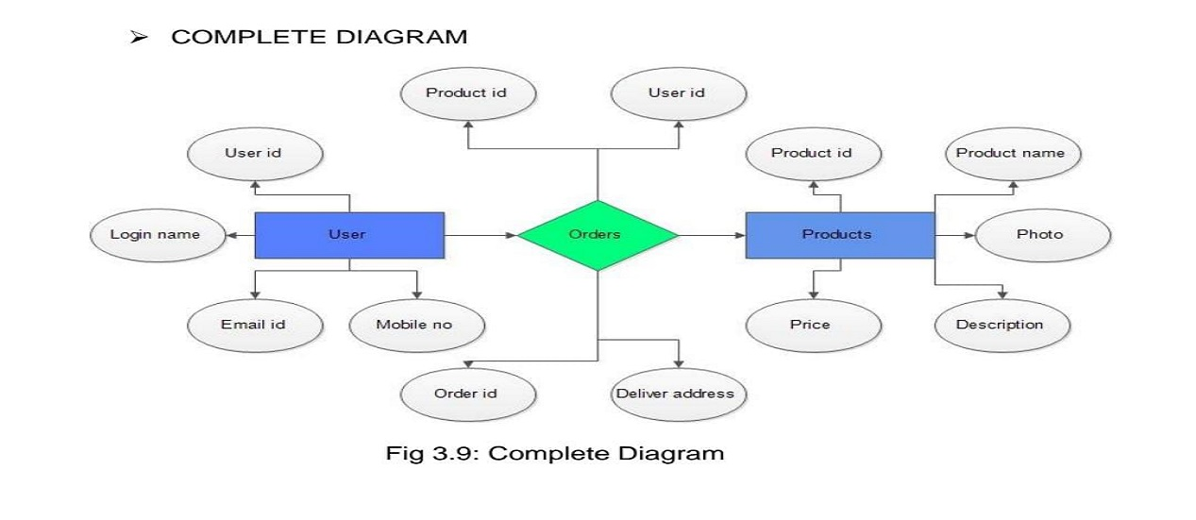
ENTITY RELATIONSHIP DIAGRAM

Slide 10
UML DIAGRAMS
UML, short for Unified Modeling Language
It is a standardized modeling language consisting of an integrated set of diagrams, developed to help system and software developers for specifying, visualizing, constructing, and documenting the artifacts of software systems, as well as for business modeling and other non-software systems.
The UML is a very important part of developing object oriented software and the software development process.
The UML uses mostly graphical notations to express the design of software projects.

Slide 11
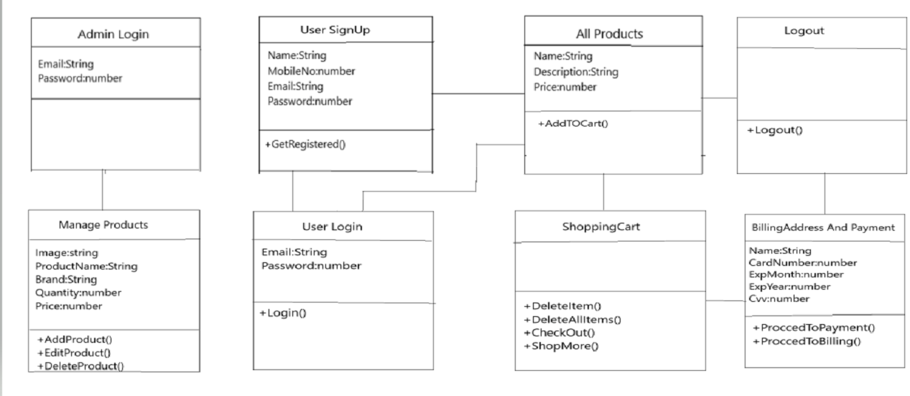
CLASS DIAGRAM

Slide 12
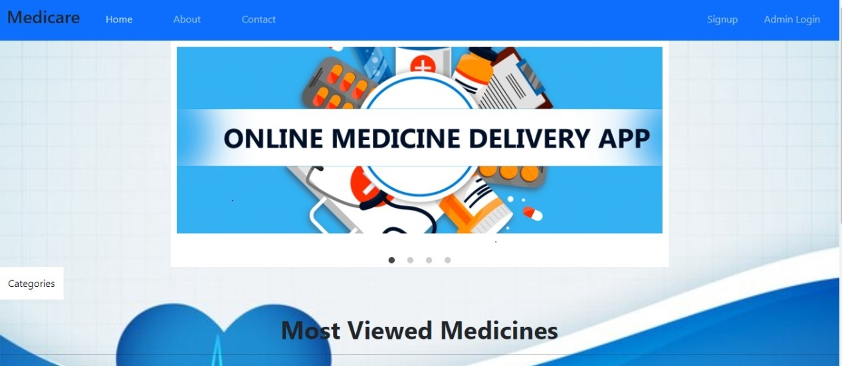
OUTPUT SCREENSHOTS
HOME PAGE

Slide 13
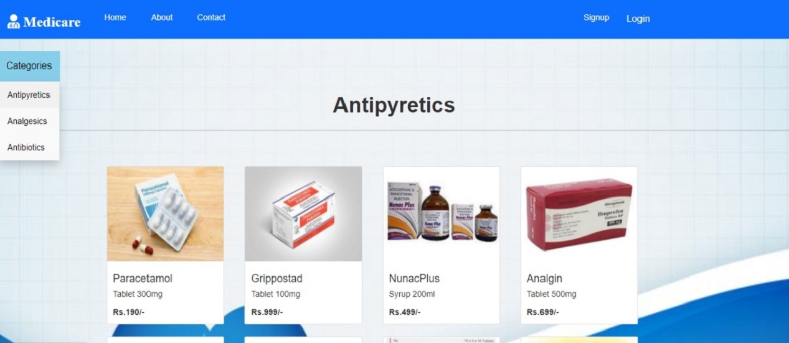
CATEGORY PAGES
ANTIPYRETICS

Slide 14
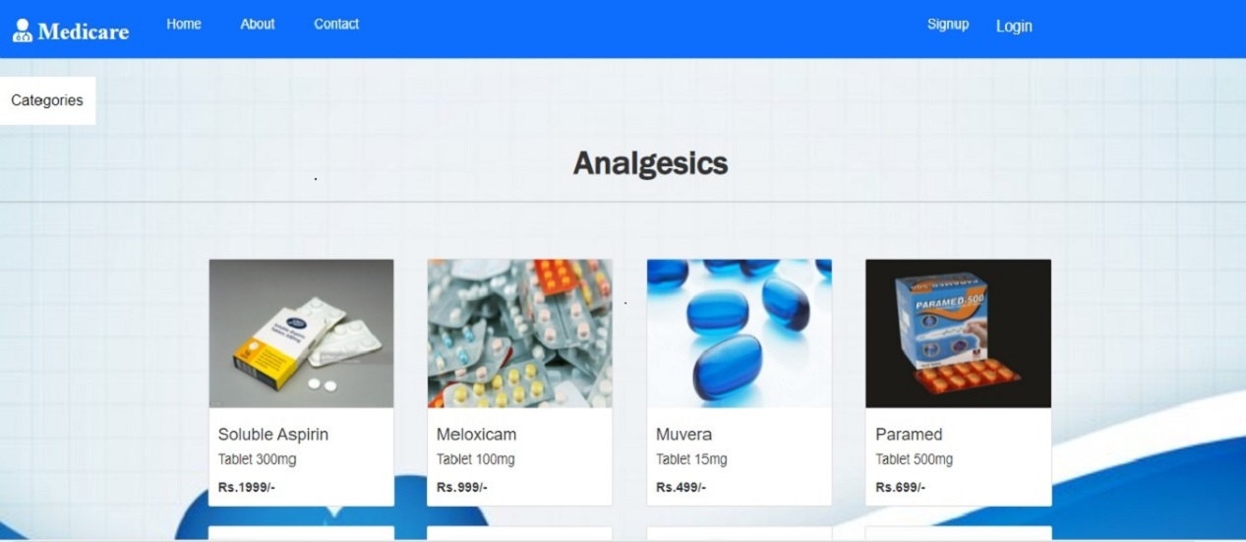
ANALGESICS

Slide 15
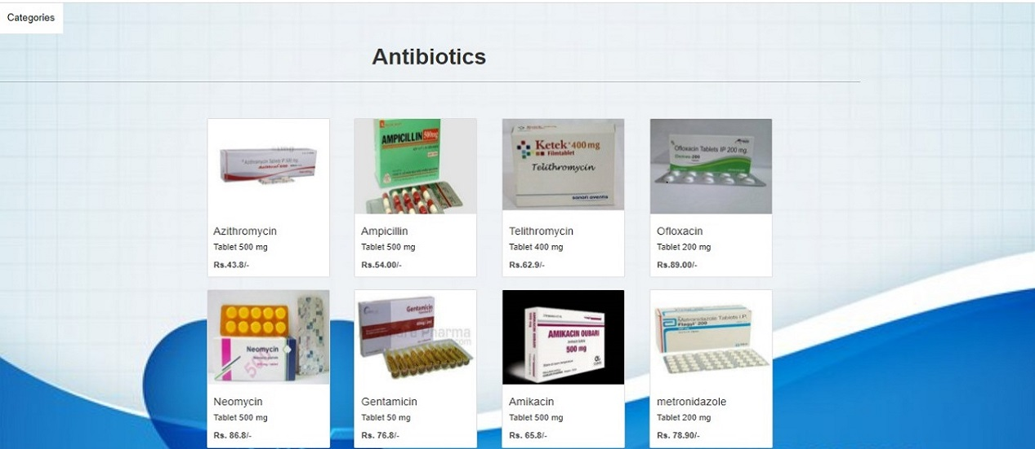
ANTIBIOTICS

Slide 16
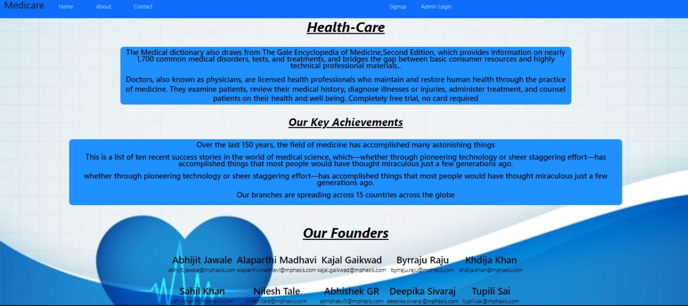
ABOUT US PAGE

Slide 17
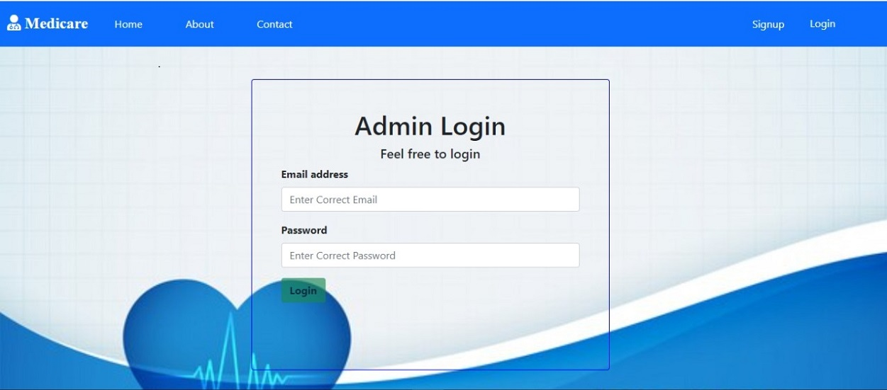
ADMIN LOGIN PAGE

Slide 18
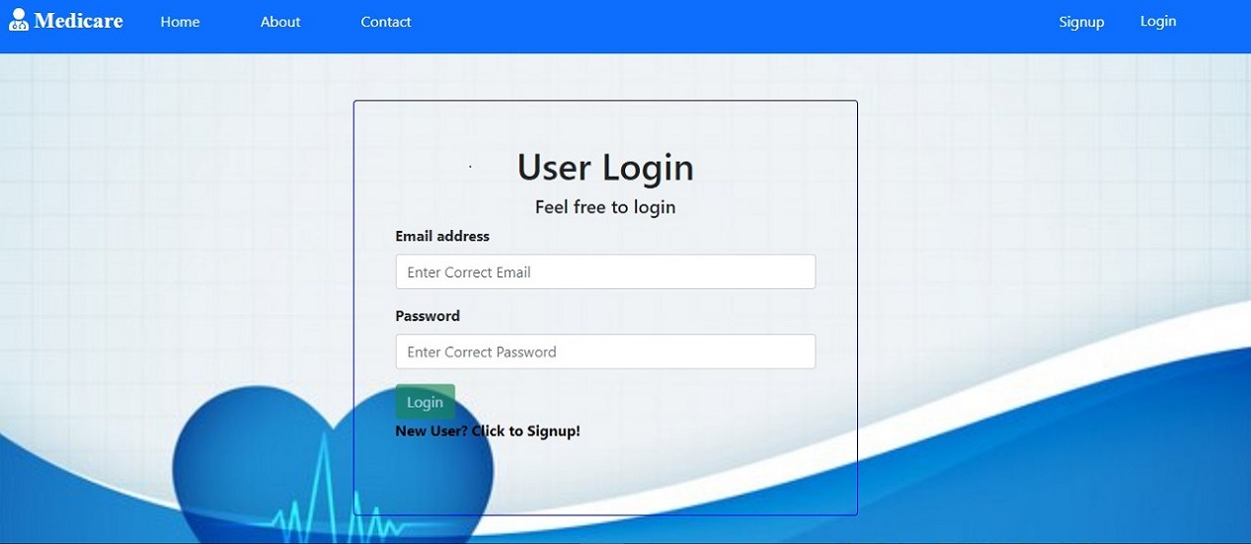
USER LOGIN PAGE

Slide 19
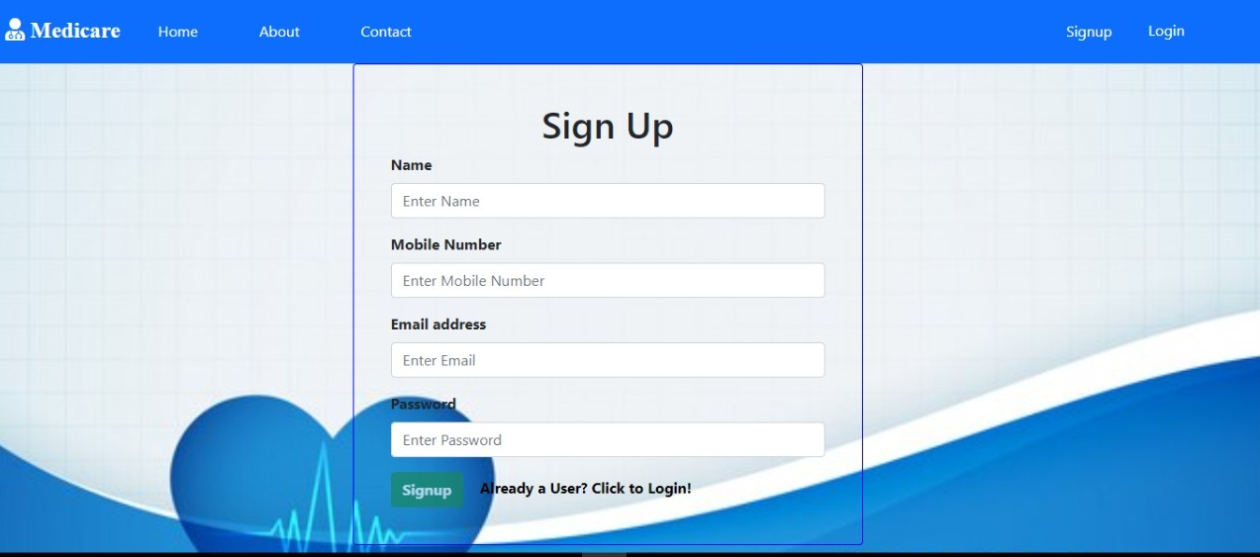
SIGN-UP PAGE

Slide 20
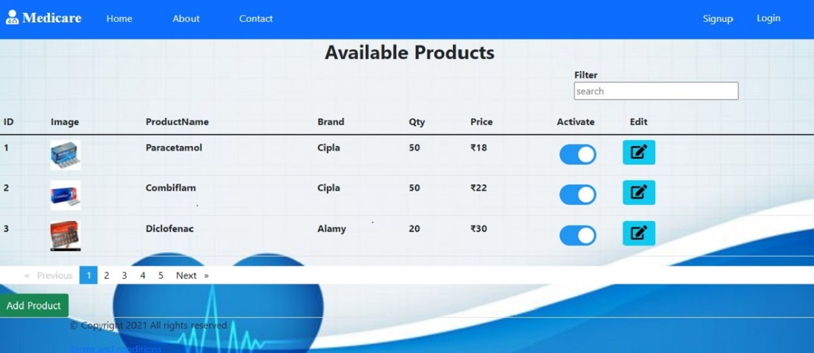
AVAILABLE PRODUCTS

Slide 21
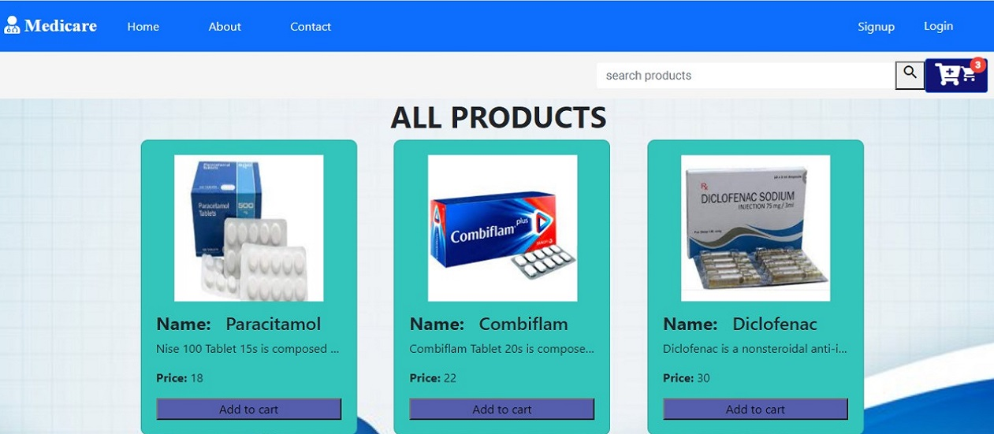
ALL PRODUCTS

Slide 22
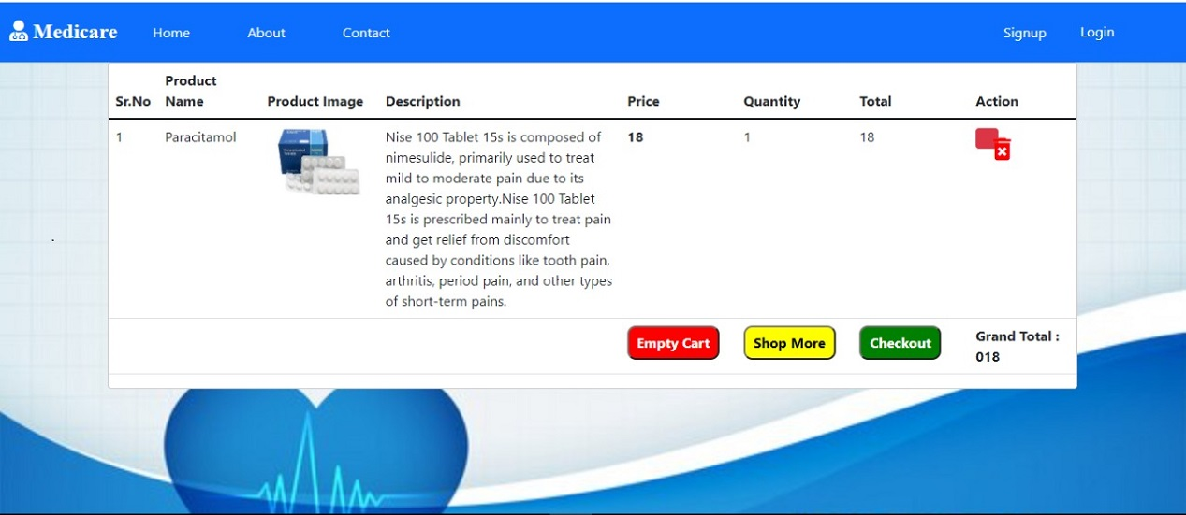
CART LIST PAGE

Slide 23
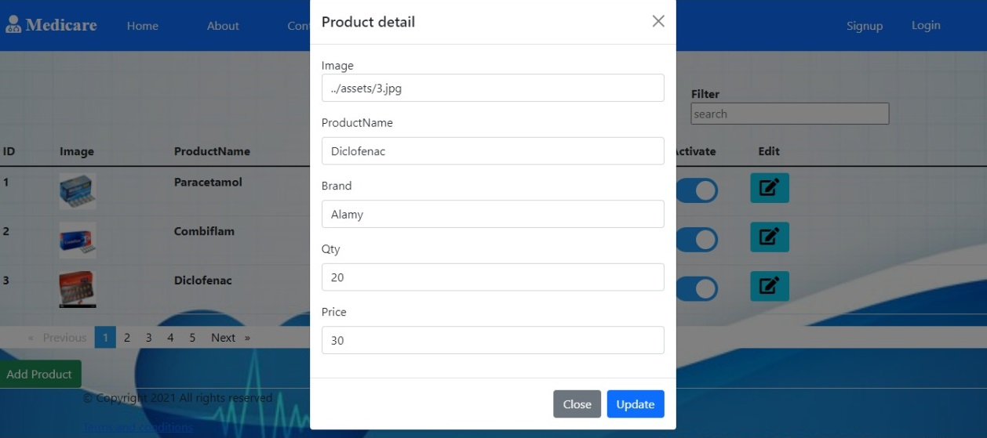
UPDATE MEDICINE DETAILS PAGE

Slide 24
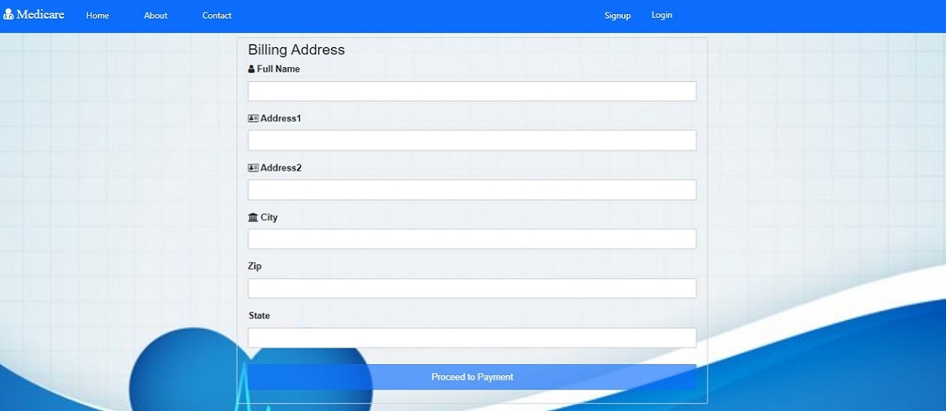
Billing address

Slide 25
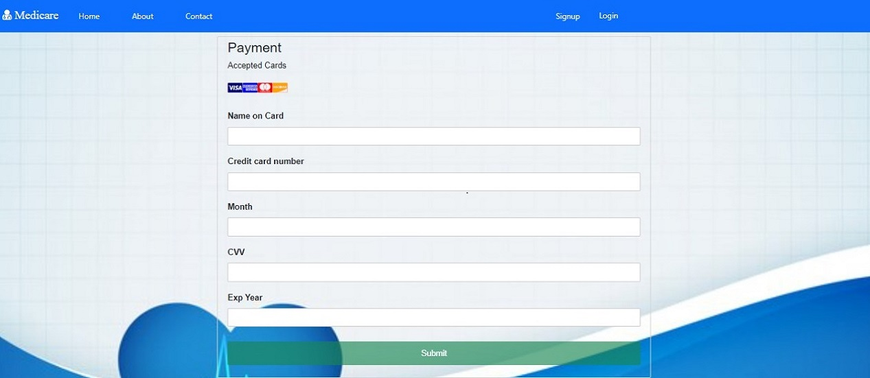
PAYMENT PAGE

Slide 26
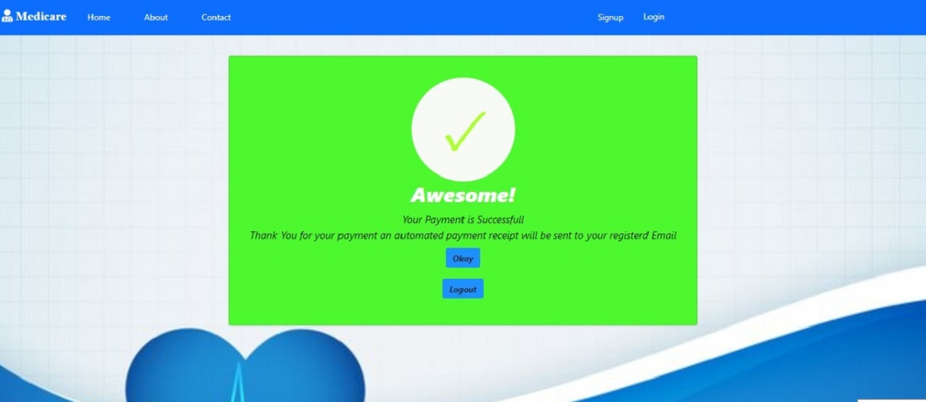
Payment successfully

Slide 27
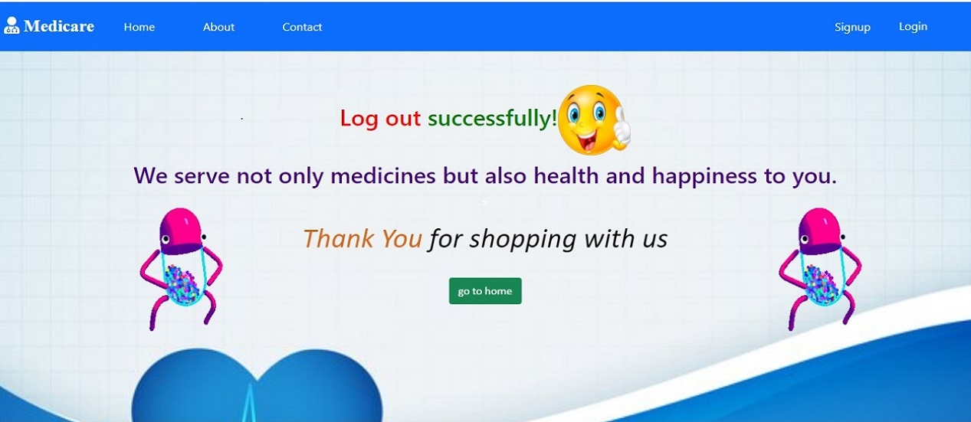
LOGOUT PAGE

Slide 28
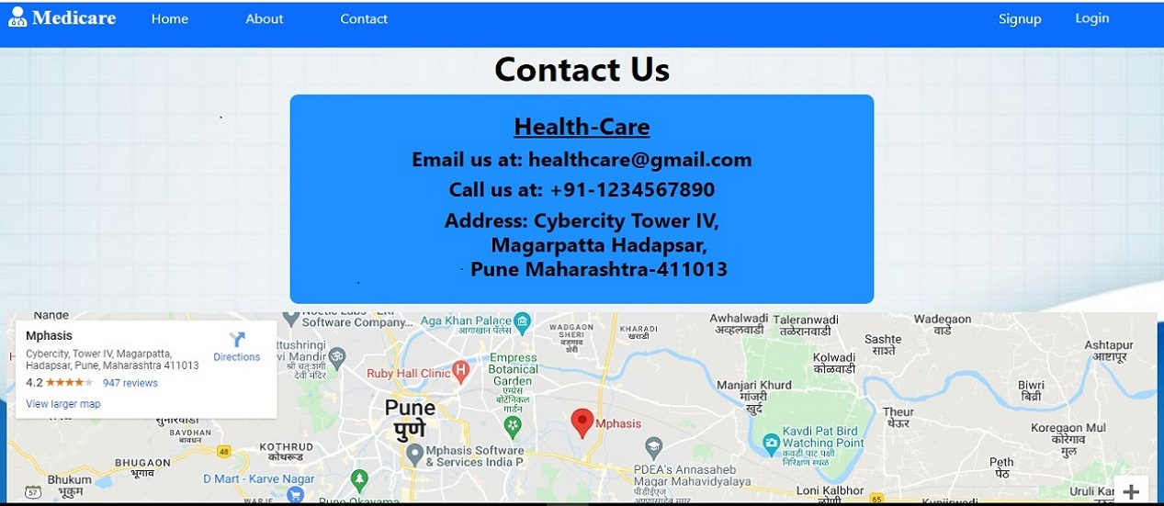
CONTACT US PAGE

Slide 29
ADVANTAGES
User can view details of the medicines without going anywhere.
User can change their delivery address
It is convenient for users as this system provides accurate cost and description of the system.
The website is flexible to be used and for e-shopping.
User can view different categories of product of different pharma company at a single place.

Slide 30
CONCLUSION
Our project is only a humble venture to satisfy the needs to manage their project work. Several user-friendly coding has also adopted.
The objective of software planning is to provide a frame work that enables the manger to make reasonable estimates made within a limited time frame at the beginning of the software project and should be updated regularly as the project progresses.
We understand the problem domain and produce a model of the system, which describes operations that can be performed on the system.
We included features and operations in detail, including screen layouts.
We designed user interface and security issues related to system.
Finally, the system is implemented and tested according to test cases.

Slide 31
FUTURE SCOPE
Use of digital technologies and telecommunications, such as computers, the Internet, and mobile devices, to facilitate health improvement and health care services.
In future, with this we can implement to take appointment with the doctor And can connect to any doctor in the world.
Assist individuals in monitoring their own health conditions, such as heart disease, diabetes, pregnancy, mental health, and more.
The purpose of all these works aims to provide user a pleasuring experience and great user interaction. Technology changes the life, so learning new technique constantly is quite necessary and important.

Slide 32
References
W3Schools https://www.w3schools.com/
Bootstrap https://getbootstrap.com/
Medicine Shopping http://dspace.daffodilvarsity.edu.bd:8080/handle/123456789/5013
GeeksForGeeks https://www.geeksforgeeks.org/
YouTube https://www.youtube.com/

Slide 33
THANK YOU

